Slide 1
AI PROJECT
AUTOMATIC WATER METER IMAGE READING
USING
DEEP LEARNING

Slide 2
Introduction
Many tasks that require a big workforce needs to be automated. The consumption of utilities such as electricity, gas, and water is monitored by meters that need to be read by humans, is one of them.
The process of traditional water meter reading involves the deployment of trained personnel by the organization to survey every single house and other properties in their list to note down consumption metrics. This data is later aggregated manually and bills are prepared to be sent to the respective consumers for further perusal.
A handful of limitations and potential drawbacks to this existing process have a direct impact on cost borne by the organization and level of inconvenience experienced by the consumer. Now the newer technologies in the domain of Computer Vision can be leveraged to make the process cost-effective and streamlined.

Slide 3
Challenges in the current system
Despite taking the photos of meters by the representatives, they have to take manual readings to collect them into a centralized spreadsheet for preparing bills
15-20% Bills have to be generated from backend(average billing) without having actual readings either because the premises are locked or there are some defects in the meter
Even after putting all the efforts, representatives are unable to visit all the houses hence some % age of bills remain undistributed
Multiple versions of the same data may exist due to error discovered after the readings have been logged
Meters can get dirty or even damaged over time making it prone to inaccurate readings and even sometimes frustrating for the representatives
Photos captured by representatives are at times not readable as they are out of focus
Since this operation is prone to errors, another team needs to check the proof image to confirm the readings. This offline checking is expensive in terms of human effort and time, and has low efficiency
Due to a large number of images to be evaluated, the inspection is usually done by sampling and errors might go unnoticed

Slide 4
Solution: Artificial Intelligence Technology – Computer Vision
An aggregate of all the challenges mentioned has a direct impact both in terms of costs and convenience. So the process needs to be certainly made more robust in terms of what data is collected and how it is collected.
Solution:
As mentioned above that reading photos using AI techniques will save lots of time and manpower and make the system robust but there is a further scope of improving the system by completely automating it by getting the cameras installed on the meter boxes. It can bring the revolutionary change in the existing system
Image-based AMR has advantages such as lower cost and fast installation since it does not require renewal or replacement of existent meters
No human intervention required in this system hence the level of accuracy will reach the maximum
Also it will be an answer to all the challenges current system has.

Slide 5
Computer Vision
Computer vision is the field of computer science that focuses on replicating parts of the complexity of the human vision system and enabling computers to identify and process objects in images and videos in the same way that humans do.
It is a field that has gained tremendous advancement with the increased accuracy rates of object identification and classification. Computer Vision, which in simple terms, trains computers to understand and interpret the visual world. It is a science that combines theory and technology to build artificial systems for obtaining information from images or multi-dimensional data.
By advances in artificial intelligence and innovations in deep learning and neural networks , the field has been able to take great leaps in recent years and has been able to surpass humans in some tasks related to detecting and labeling objects.
Computer Vision in artificial intelligence follows three consecutive processes that execute one after another.
Image acquisition
Image processing
Image analysis and understanding

Slide 6
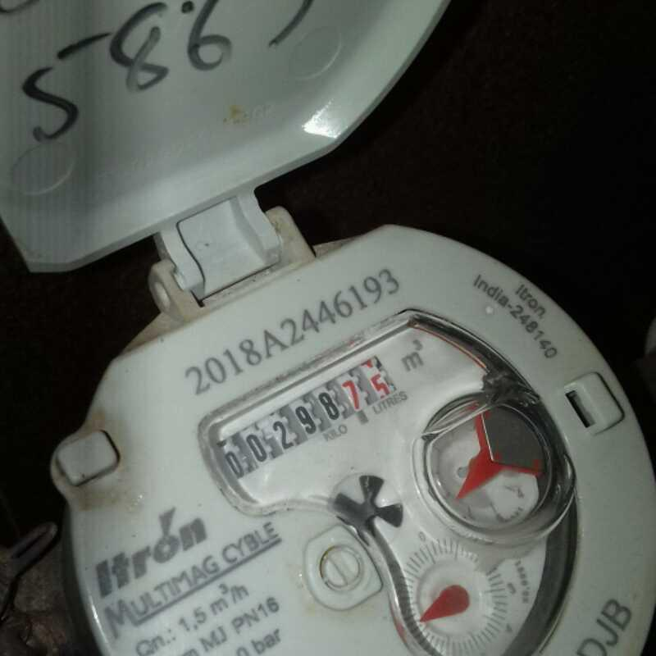
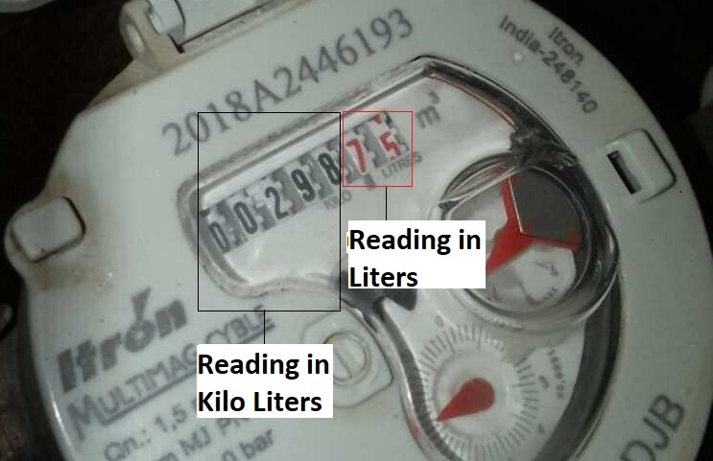
Goal of the Project : The goal of the project is to read the exact consumption of water in kilo liters from the image of a water meter using computer vision. Below are images of the water meters and the region of interest to be extracted and read by the system.
Water Meter Image
Labelled Image

Slide 7
Workflow Design : Automatic Water Meter Image Reading Project
In this project, we have designed a three-stage approach for AMR. We first detect the counter region, crop it and then tackle the digit segmentation and recognition stages jointly by leveraging the high capability of Deep Learning techniques i.e. Convolutional Neural Networks.
To achieve this goal, the YOLO system (you look only once) has been adopted. The algorithm makes use of a convolutional neural network with special characteristics. To train the network we need to design the image labels, crop it, create the segments containing digits and then read the digits.
So below are three stages in which we have divided the project:
Detecting the Region of Interest
Cropping it
Digit Labelling and Recognition

Slide 8
Stage 1 : Detecting the Region of Interest
In order to detect the region that contains the reading , we have used convolutional neural network (CNN).
To achieve this goal, the YOLOv4 system (you look only once) was adopted. The algorithm makes use of a convolutional neural network with special characteristics. The network has only fully connected convolutional networks(FCN) called Darknet.
Step 1: Label the images of water meter by drawing the bounding boxes around the part of the meter corresponding to the kilo liters. We have labelled 1000 images with the aid of the LabelImg software for the custom class “reading”. It has generated the text file for each image that we have labelled which contains the coordinates of the area we have labelled.
Step2: Using the above coordinates we have trained the custom Yolov4 model for class “reading”.
Step3: Saved the results of the test images in a text file named “result”

Slide 9
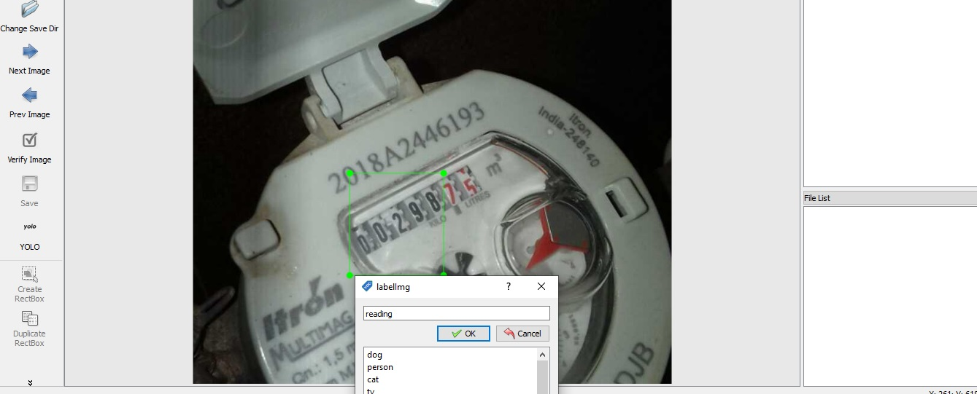
Bounding Box of “Reading Class” in LabelImg Software:

Slide 10
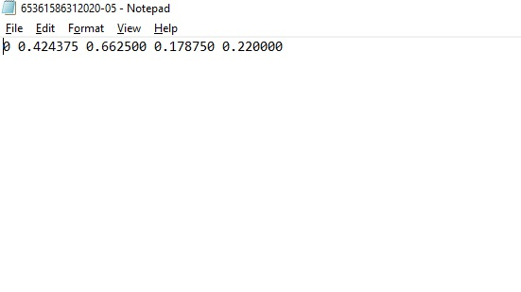
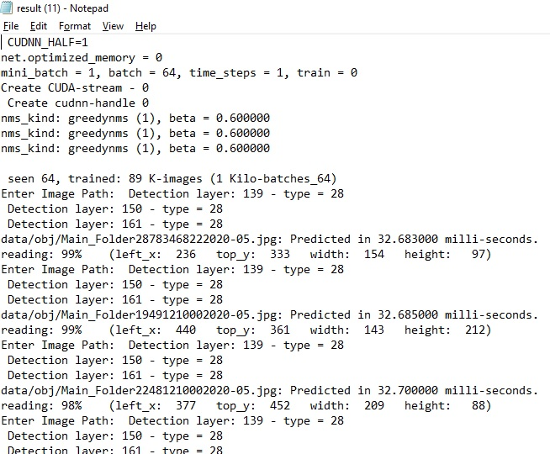
Code to train the custom Yolov4 model for class “reading” :
Open the below link in the browser:
https://colab.research.google.com/drive/1527xg0bqsRGRSEmqxo_ncZNRIIMfMMHi?usp=sharin
Note : The code is self explanatory
Text File Created by LabelImg
Result File Generated by Yolo Model

Slide 11
Stage 2 : Cropping the Region of Interest (Bounding Box)
Since the coordinates generated by LabelImg software are understood by Yolo only so we have trained the model using these coordinates of our region of interest and saved the result in a text file i.e. “result.txt”.
Now we have a trained model which can find our region of interest for any unseen image with a high accuracy. It creates a bounding box and gives the coordinates of the same which can be used to extract this particular region from the image.
The results generated in the result.txt file have the coordinates of the bounding box which we have used to extract the region from the image and saved it in a folder in order to use these images as the input for training another model to read the digits of this image and get the reading of the water meter.
These coordinates represents
Left X: Top left corner of the portion of image we want to crop in X direction
Top Y:Top corner of the portion of image we want to crop in Y direction
Width: Adding this value to Left X can give the end point of portion of image we want to extract in X direction
Height: Adding this value to Top Y can give the end point of portion of image we want to extract in Y direction

Slide 12
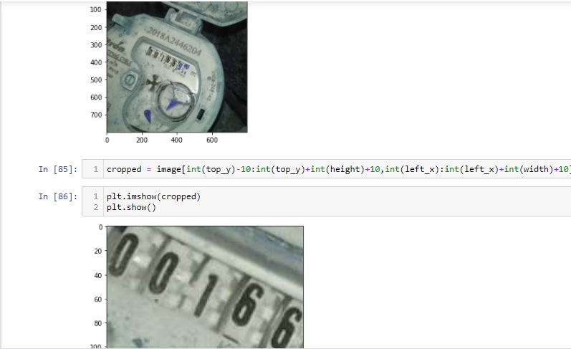
Code to Crop the Region of Interest (Bounding Box): Open the link: Open link Open file “Extracting Coordinates of main reading.ipynb”

Slide 13
Stage 3 : Digit Labelling and Recognition
In the last section, we have cropped the region of interest from the images and saved them in a folder as a new set of images.
In this stage, we have used these images as input to train another Yolov4 model for reading the digits present in the image.
To recognize the digits present in the image model needs to be trained for the digits from 0 to 9. Hence we have created 10 different classes for all the 10 digits as “0”, “1”, “2”, “3”, “4”, “5”, “6”, “7”, “8” and “9” in LabelImg software and have labelled around 1000 images.
Created the bounding boxes of the all the digits present in the image
Now we have trained the model using the coordinates generated by the software and have given the cropped images as input.
The trained model can now identify all the digits with a high accuracy and saved the result in “result.txt”. We have changed the name after downloading to avoid the confusion with the result of previously trained model
Finally the reading had been extracted from this text file using a code and saved in “.csv” file

Slide 14
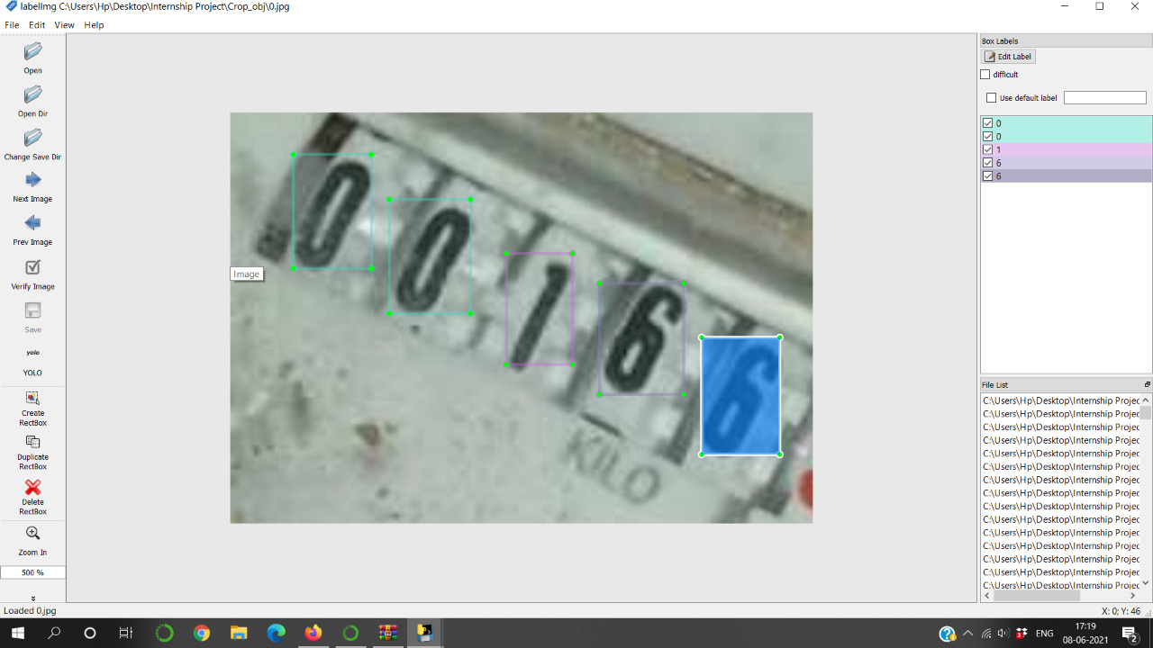
Bounding Boxes of Classes (0-9) in LabelImg Software:

Slide 15
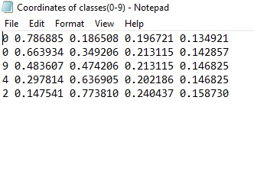
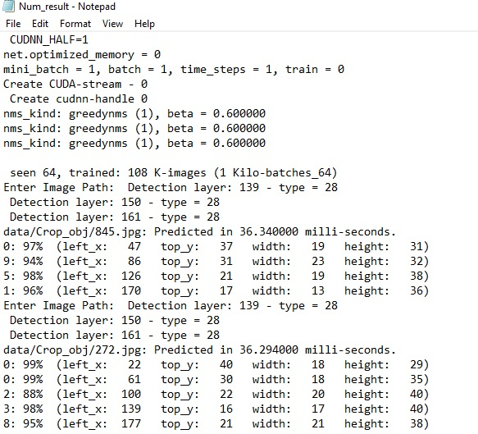
Code to train the custom Yolov4 model for classes 0 to 9:
Open the below link in the browser:
https://colab.research.google.com/drive/1lL9uCNxBqvYVgO_Z3LwVEfz_dmUGKSp9?usp=sharing
Note : The code is self explanatory
Text File Created by LabelImg
Result File Generated by Yolo Model

Slide 16
Code to extract the reading from the image :
Open the link : Open Link
Open file “Code to extract Classes.ipynb”
Results : Saved in “Result.csv” or “Result.xlsx” file
Open the file : Open File

Slide 17
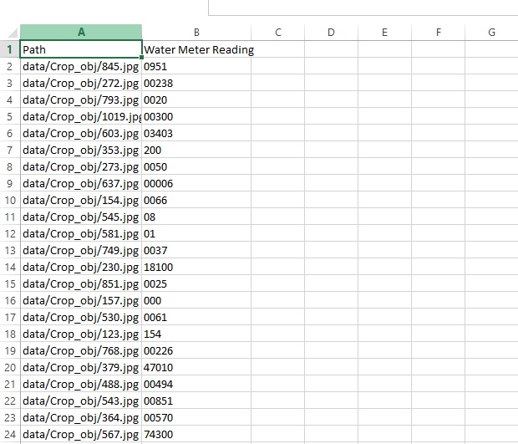
Code to extract the reading from the image :
Open the link : Open Link
Open file “Code to extract Classes.ipynb”
Results : Saved in “Result.csv” or “Result.xlsx” file
Open the file : Open File
Water Meter Readings in file saved

Slide 18
Thank You!

